Slide 1
Maths Daily Practice
Grade 1 - Week 5
Complete this work in a notebook at home. This is not mandatory homework.
Therefore, it does not need bringing into school. This is optional practice to support the learning taking place in school.

Slide 2
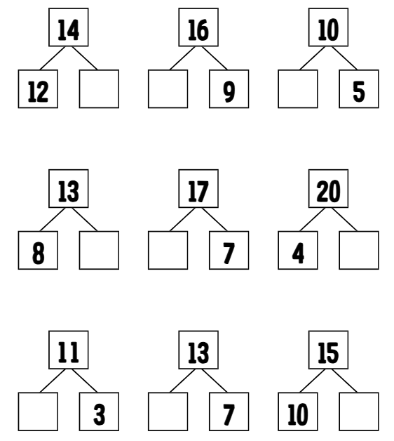
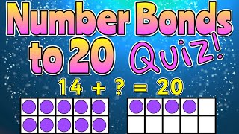
Daily practice 1
Number Bonds of 20
Complete the part-whole models by writing the correct numbers in the spaces.

Slide 3
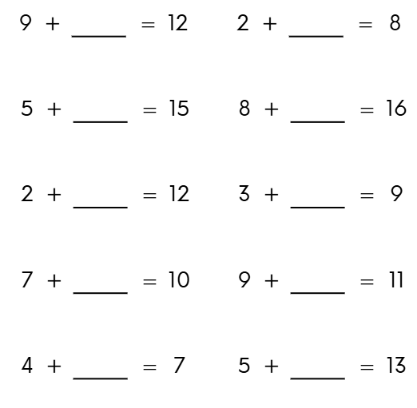
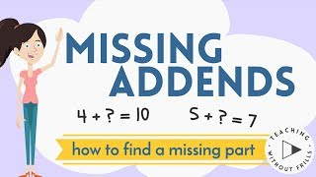
Daily practice 2
Missing Number
Addition

Slide 4
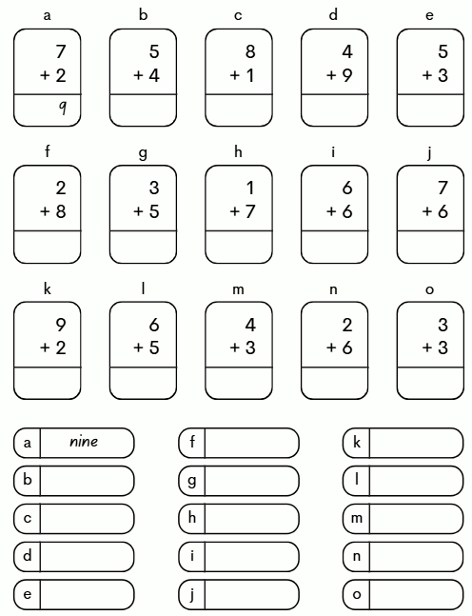
Daily practice 3
Column Addition &
Spelling

Slide 5
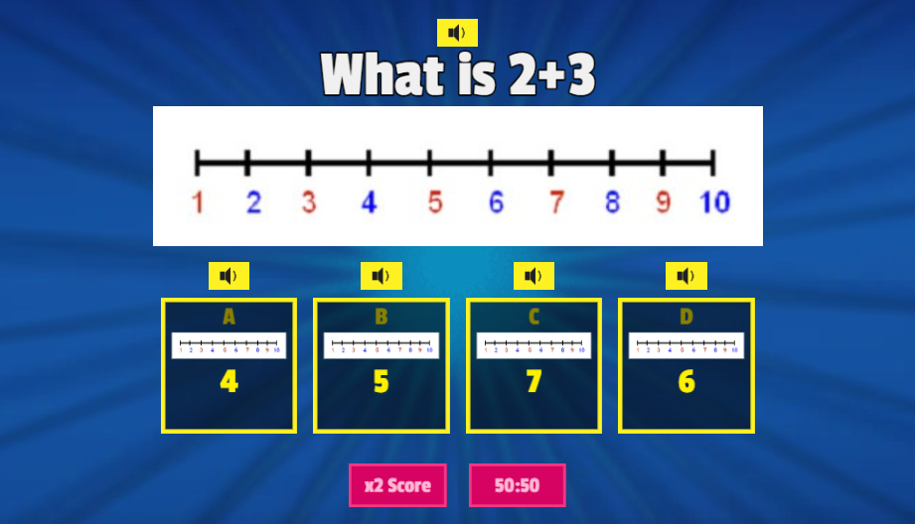
Daily practice 4
Addition on a number line - Quiz
Number Line Addition - Gameshow quiz

Slide 6
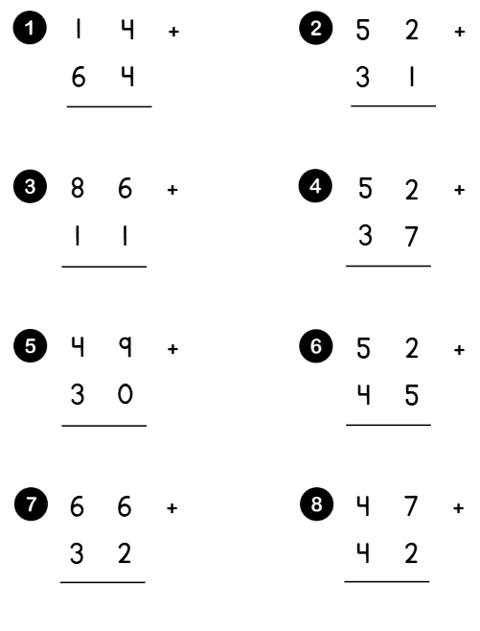
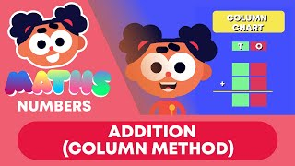
Daily practice 5
2-Digit Column Addition

